Slide 1
Inclusive and Informed Politics in Transboundary Governance of Kosi
Srinivas Chokkakula, Ph D
Centre for Policy Research, New Delhi
srinivas@cprindia.org

Slide 2
Structure
The research question, analytical frame
The case of Kosi
What is transboundary governance of Kosi?
The institutional context
The context: “a snake in the knots”
Politics
the contentious history
Entrapped: the multiscalar politics
Construction of antagonisms
A tale of two times: 2008 and 2014
Challenges of access to information and inclusive politics

Slide 3
Research Question
Transboundary river water governance is essentially a statist project. But it is also true that nonstate actors and their politics shape and influence its outcomes.
How do the nonstate actors engage with transboundary governance (inclusive), to what end? How does “improved access to information” impact this engagement (informed)?

Slide 4
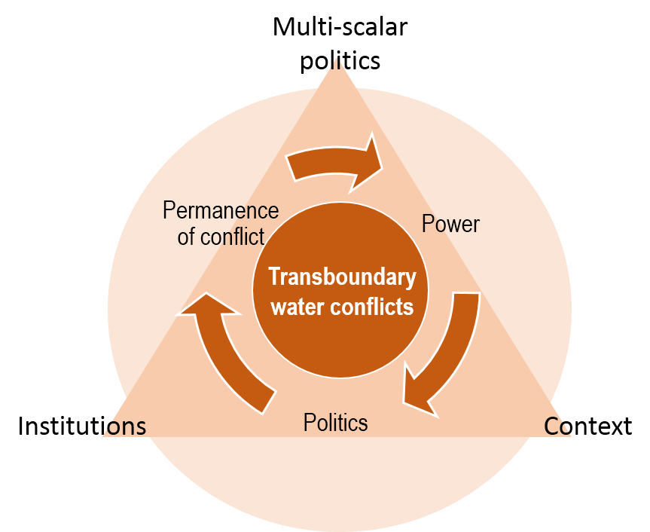
Analytical Frame
Literature identifies three sets of factors contributing to transboundary water cooperation:
Political relations
Context (geographical, historical, social and ecological)
Institutions
(Wolf 1998, 1999a, 199b, 2003; Wolf, Yoffe and Giordano; 2003; Giordano, Giordano and Wolf 2003; Giordano and Wolf 2003; De Stefano,Edwards, De Silva and Wolf 2010 – OSU’s TFDD based writings)
Source: Chokkakula, 2015

Slide 5
Analytical Frame: Understanding Multiscalar Politics
Political relations, though understood as interstate bilateral relations, also include the multiscalar politics of actors other than nation-states.
How do these politics play out and impact transboundary governance outcomes?
Inclusive and informed politics
Engaging with the statist project
Decentering of state and democratization

Slide 6
The case of Kosi

Slide 7
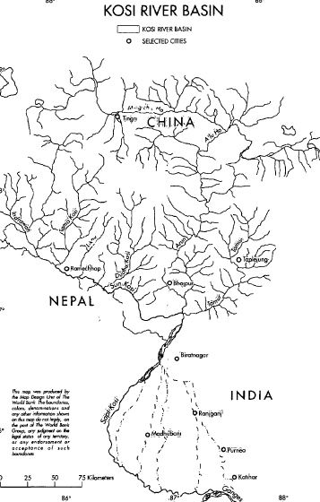
Transboundary Context
Kosi drains an area of about 92,530 km². [Tibet – 33%; Nepal – 45%; India – 22%] (Sharma 1997).
Major tributary of Ganges, flows through a narrow george before opening up to plains at Chatra (a key reason for its current transboundary interest!)
The fan structured delta in India is a result of the river shifting its course by about 112 km over the last 250 years.
Source: Regmi 2013, adaptatted
BANGLADESH

Slide 8
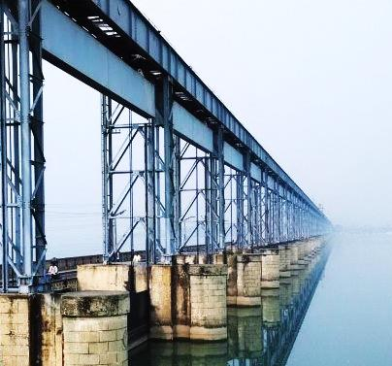
Transboundary Governance of Kosi
Kosi project is essentially a flood protection system from 1960s.
Nehru (1951): “It is my opinion that the Kosi Project is very necessary and should be somehow constructed. We must make a start even though it may take a few years to complete because, as you know, in some parts of Bihar every year a strange difficulty arises, bringing disaster and ruin.”
Managing the protection works including the barrage for coping with flood risk is the key transboundary governance challenge.
The other …

Slide 9
Transboundary Governance of Kosi: The High Dam
Proposed ‘High Dam’ of 228.6 m height on Chatra gorge (upstream of Barahkshetra).
1400-1800 MegaWatt power
Irrigation benefits for 16.6 lakh ha in Nepal and Bihar
Stabilize flows in Ganges with possible benefits to Bangladesh
The design issues are not yet settled, but the locations varied over time by number of committees set up for studying the feasibility.
NEPAL
INDIA
Kosi Barrage
Image source: © WWF

Slide 10
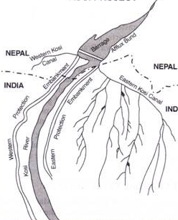
Transboundary governance of Kosi: the barrage and other
Barrage of 1.15 km long
Flood protection works:
Embankments running to a length of 315 km on either side , also upstream and downstream
Irrigation:
Eastern Kosi Canal to irrigate 5.66 lakh ha in Purnea, Saharsa districts of Bihar
Western Kosi Canal to irrigate 0.85 lakh ha in Saptari and Moranga districts in Nepal.
Power:
on Eastern Canal, 20 MW power, with a share to Nepal.
Source: ShortParagraph.com

Slide 11
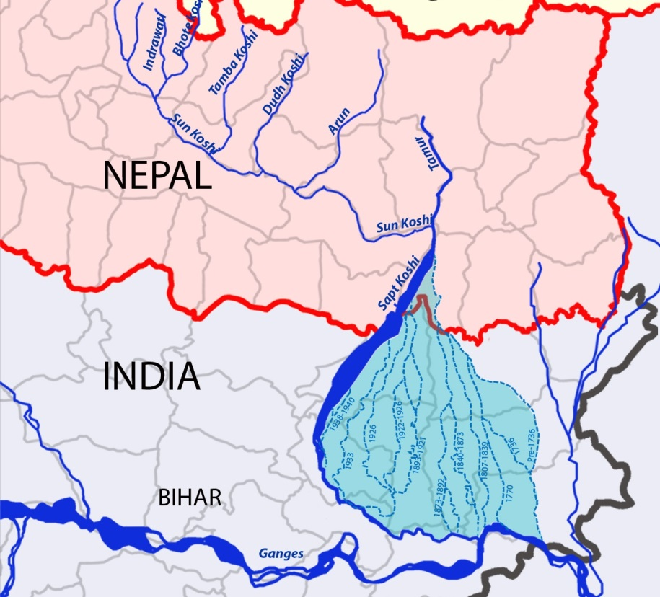
Context: “A snake in the knots”
Perennial river with largest elevation drop in upper reaches and low head lower reaches making it hazardous for glacial lake outburst, debris flow, landslides, flooding, soil erosion and sedimentations (Chen et al 2013)
high siltation and shifting course > posing flood risk – Bihar’s River of Sorrow
Random nodal avulsion than systematic unidirectional shift (Chakraborty et al 2010)

Slide 12
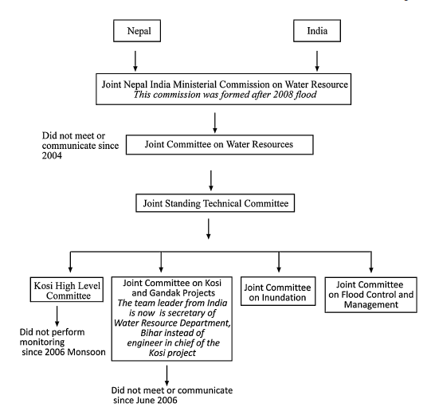
Institutions: Transboundary Governance
“Multiple layers of institutions …”
Vijay Choudhury, Minister of Water Resources, GoB
Bilateral | Joint Nepal-India Ministerial Commission on Water Resources (post-2008 floods) Joint Committee on Water Resources Joint Standing Technical Committee Joint Committee on Kosi and Gandak Projects Joint Project Office
National | Ganga Flood Control Commission Central Water Commission Indian Meteorological Department
State | Bihar State Water Resources Development and Irrigation Department
Standard Operating Procedures (GoB’s Post-2008) | Identified set of activities round the year for repair and maintenance of flood protection works (both in India and Nepal)
Source: Regmi 2013, GoB SoP

Slide 13
Institutions: Transboundary Agreements
The 1953 floods triggered the first concrete steps to address flood risk of Kosi, which led to the Kosi Agreement 1954.
Revised in 1966 agreement to address Nepal’s concerns and unhappiness about unequal benefits (Salman and Upreti 2003); around this time, the barrage was constructed.
Surveys, extensions need prior approval of GoN
Reaffirming Nepal’s right to withdraw water from Kosi
Entitlement of up to 50% of power generated within 10 miles of project site
Ownership of lands acquired for the project converted to lease
Continuation of the Joint Indo-Nepal Kosi Project Commission

Slide 14
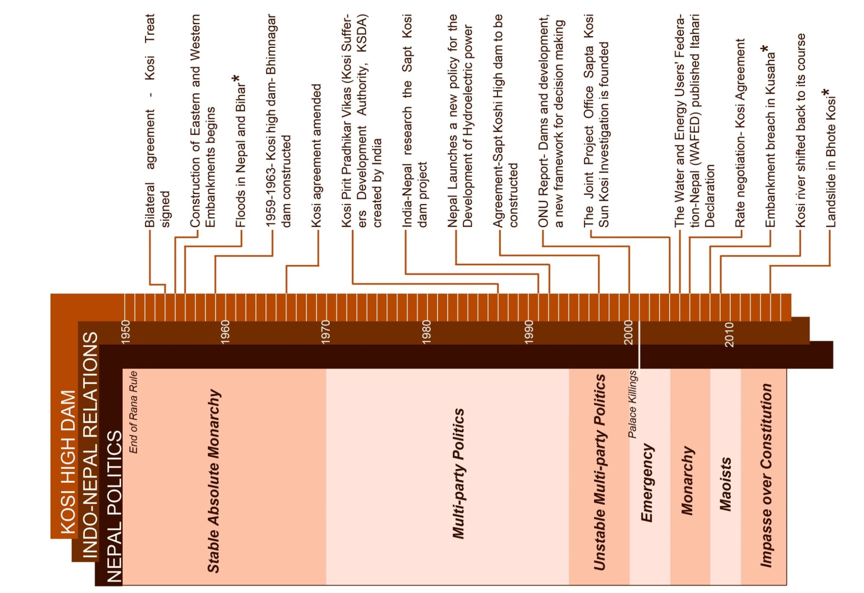
Politics: The Contentious History
INDIA POLITICS - STABLE
1950 India-Nepal Peace Treaty
NEPAL POLITICS - UNSTABLE

Slide 15
Politics: A Contentious History
The tenuous history of Kosi is riddled with negotiations over several contentious issues (Salman and Upreti 2003):
Over execution of the project
Over land ownership and sovereignty
Regarding water and power use
Regarding navigation and fishing rights
“Small countries have a tendency to think that they have been outsmarted, and the big countries tend to think that they have been more generous than necessary.” (Salman and Upreti 2003: 80)
There appears some learning from the Kosi agreement, which is reflected in Gandak and Mahakali agreements.
But the discursive politics of these negotiations contributed to the reinforcement of antagonisms - colouring any exchange/dialogue between India and Nepal.

Slide 16
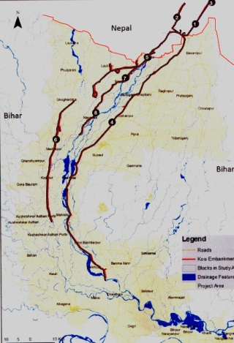
Politics – ‘Entrapped:’ The Political Economy of Embankments
“Embankment Assets” which include a total 315 km length of embankments
Out of which, 59 km of Afflux Bunds on the upstream of the Barrage (in Nepal)
447 Spurs; 8 Bed Bars; 3 Bridges
Planning Commission’s evaluation (1979 – R K Shahi) of embankments showed : ineffective in flood control, decreasing agricultural productivity, water logging, epidemic vulnerability etc.
“Embankment Mafia” – as much as 60% of Rs 250-300 crore pocketed by politician-engineer-contractor nexus (Bharti 1991)
LASA’s K-EAMS (Kosi Embankment Asset Management System).
Source: LASA 2014

Slide 17
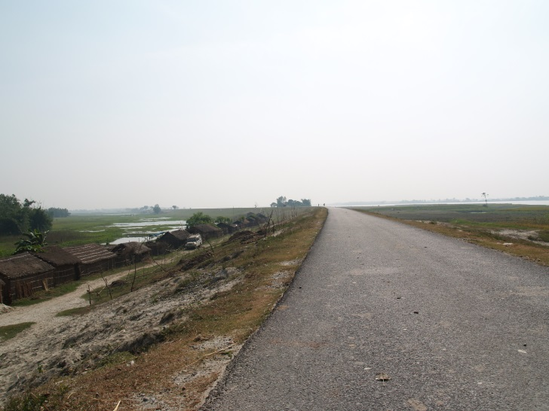
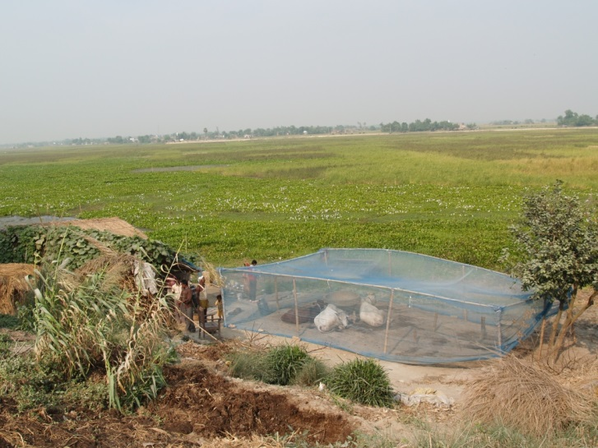
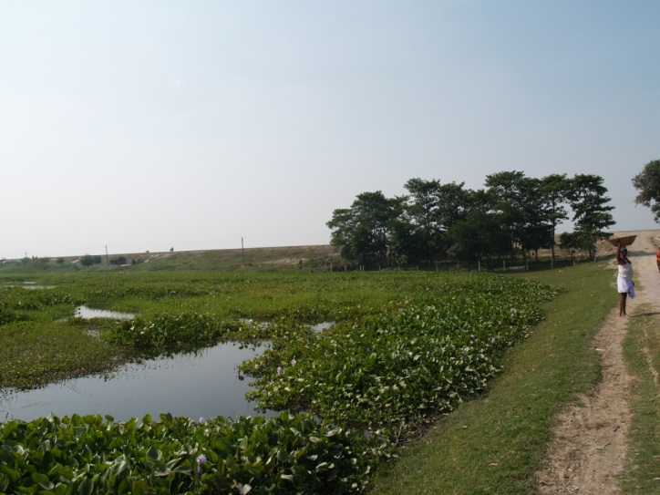
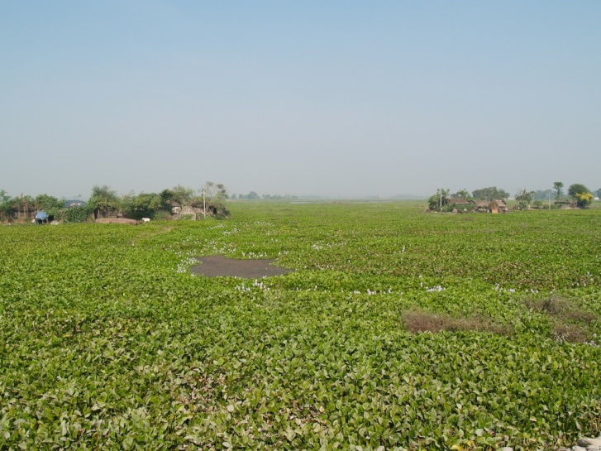
Politics – ‘Entrapped:’ Transformed Political Ecologies
Embankments economy closely linked to populist politics (Mishra 2008).
Formal accounts claim having protected 20 lakh ha from floods.
But the embankments transformed the political geographies of people close to a million:
Displacement
Social exclusions
Livelihoods

Slide 18
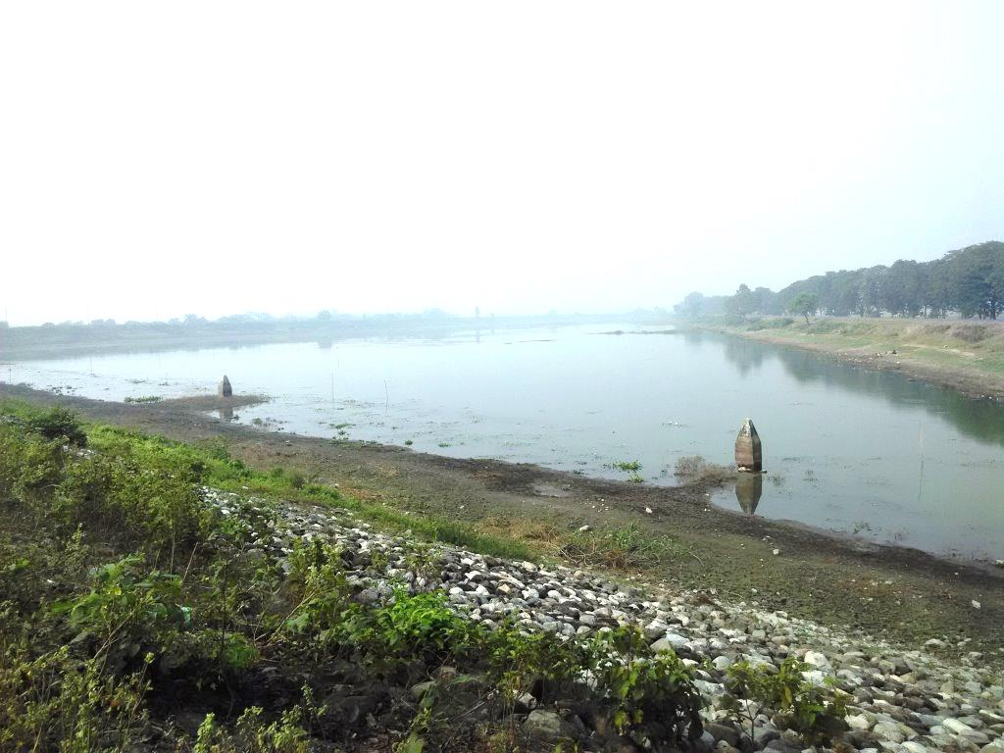
Politics – ‘Entrapped’ The other side: Identity and Betrayal!
Remain equally vulnerable to floods. The Kosi High Dam never came …
None of the benefits fully realized: irrigation, compensation, power, flood control, social amenities ... what is the guarantee that the High Dam benefits will indeed be realized?
A sense of discrimination of Terai interests, for their socio-cultural affinity and proximity.
High Dam conceived as a sediment trap; may not last long – 37 years (Dixit 2009).
The Border No Man’s Land…. or TRUST?
MISTRUST – not just between India and Nepal, but also between Terai and Pahadi; Patna and Delhi …

Slide 19
Construction of Antagonisms: The Discursive Transboundary Spaces
INDIA | NEPAL
We have been too generous… Kathmandu’s approach towards High Dam is colored; mostly benefits them. Opportunistic politics – local resistance is often a blackmailing tactic. All the dues for compensation and provisions are paid to GoN; Nepal failed to deliver. Nepal does not own its responsibility for floods. | We are always taken for granted… Modi aye, Nepal ko paise dene High Dam is primarily to continue its dominance of Nepal Local resistance movements are ignored. India does not pay in time/ the benefits are inequitable. India is obliged to pay compensation for the poor management of barrage and the consequent floods.
Nepal ne paani chod diya… bhaad aye Centre delaying High Dam (JD political leaders); consider the recent reports about progress on High Dam. Local people resisted repairs… | Itne saal se hamara paani India ke liye chodte rahen … “Local resistance” – a cover up of Bihar’s (also India’s) institutional incompetence.
Bhote Kosi incident and the hype around is – “bhumika bana rahe the… High Dam banane ke liye” | Kosi and every water sharing agreement is an instance of selling Nepal’s interests to India by opportunistic political leaders.

Slide 20
Construction of Antagonisms: Opportunistic Politics
In an environment of conflicting interests, antagonistic conditions and unstable regimes, opportunistic politics thrive.
“When in office, Nepali political leaders strenuously denied reports of Indian interference; when out of the office the same leaders as strenuously decried such interference.” (Rose 1971: 201).
Opportunistic politics continuously the constructions of ‘the other’ towards reinforcing the antagonisms.
India’s casual and condescending approach: what if High Dam is filled up? “aur ek High Dam bana denge”
Nepal’s unstable regimes → mistrust, a means of political mobilization: Mahakali – “repeat of Kosi – sold off Nepal interests to India again…”
Fragmented identities and opportunistic politics contributing to Gramscian constructions of the ‘hegemon’ (India).

Slide 21
Construction of Antagonisms: Unsubstantiated and Uninformed
Most of these claims are uniformed; unsubstantiated; mostly targeted at appealing to constituencies, pursuing political agendas – both in India and Nepal; do not have clear sense of the actual costs vs benefits in the projects – Kosi Barrage / High Dam/ any transboundary water initiative.
Those informed do not see the logic in the antagonisms, believe there is adequate space for resolution of contentious issues.
How do we engage with these constructions of antagonisms, other than through better access to authentic and objective information?
But, do we recognize that knowledge production and representation is a political project?

Slide 22
A Tale of Two Times:
Floods in 2008 and “No” Floods in 2014
Notes:
http://yfebiharfloodrelief.blogspot.in/2008_09_01_archive.html

Slide 23
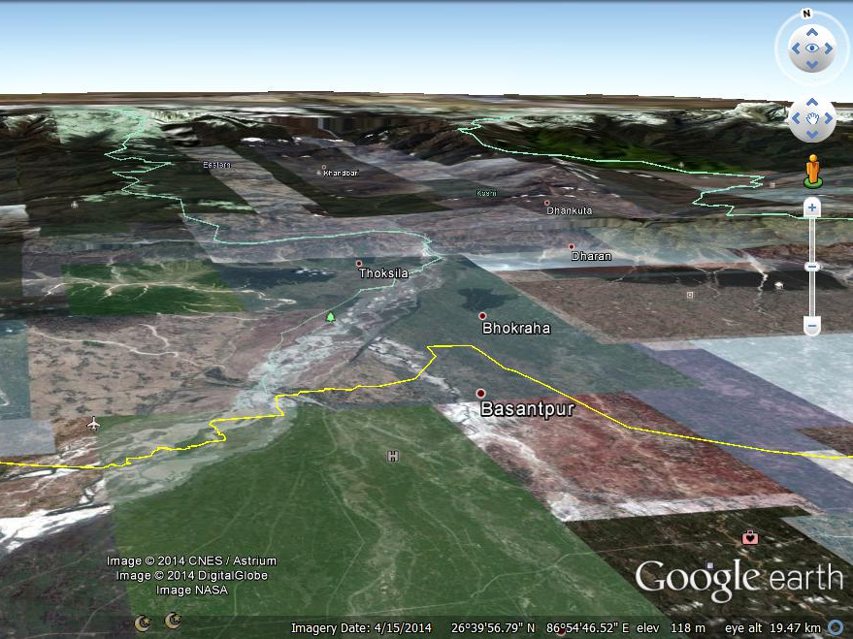
120 km

Slide 25
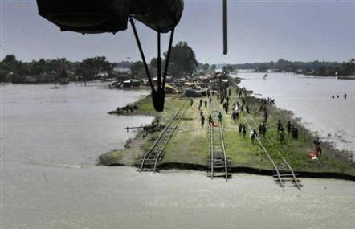
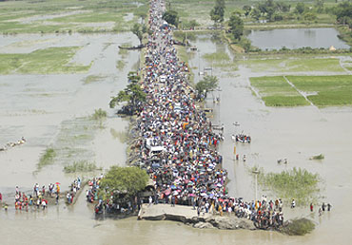
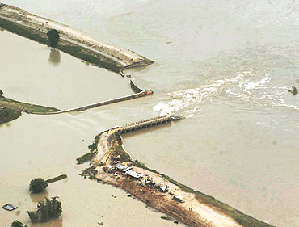
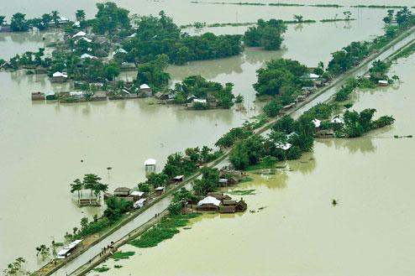
Floods in 2008

Slide 26
Floods 2008:
What happened?
An afflux bund breached on the 18th August 2008 at 12:55 pm.
Combination of heavy rains and avulsion in the absence of timely response led to breach of the Eastern bund at Kusaha.
The breach discharged at 144,000 cusecs, much less than the barrage’s discharge capacity, 950,000 cusecs (Regmi 2013). Yet, the breach happened – clearly indicating the failure of transboundary coordination mechanisms to respond.
About 15-20 km wide and 150 km long water sheet flowing at 1 ms⁻¹
In Nepal: 45,000 people displaced; 4,648 ha of crops washed away (Shreshta et al 2010)
In India: 3.07 million from 1,704 villages in Bihar affected (Mishra 2008); total losses highest in the last five decades (Kale 2008)
Notes:
http://www.boloji.com/index.cfm?md=Content&sd=Articles&ArticleID=4536

Slide 27
Floods 2008:
Failed Transborder Governance
Absence of High Dam, an integral part of the Flood Protection (CWC, GoI).
Poor maintenance of barrage and protection works by India (GoN)
Embankments wrong technological choice for flood control (Mishra 2008, Dixit 2009); were only temporary solutions (Chitale 2000).
Institutional dysfunction, negligence of duty, poor decision making, organizational incapacities and weaknesses – in India and Nepal (Balia Commission, Shreshta et al 2010, Dixit 2009)
Breach suspected well before. By 16th August 2008, Kusaha point’s vulnerability reported by local communities (Shreshta et al 2010); the first wireless about this vulnerability sent on 31 July 2014 (Balia Commission 2014).
Political turbulence in Nepal contributed to ineffectiveness of institutional arrangements (CWC, Balia Commission, GoB, Kosi Victims Society and other civic society actors in Nepal and India).
Bihar Irrigation Authorities sent contractors to repair the spurs, but they met with hostile conditions and resistance from locals in Nepal.
Notes:
http://www.boloji.com/index.cfm?md=Content&sd=Articles&ArticleID=4536

Slide 28
“No Floods” 2014
Landslide on Bhote Kosi
Landslide occurred on 2nd August 2014, early hours of 02:36 am on Bhote Kosi, a tributary – Sindhupalchok District, Central Region of Nepal.
“Massive landslide blocks SunKosi River, Downstream Nepal-India under threat” (SANDRP, 2:18 pm, 2 August 2014)
Landslide led to artificial damming of Bhote Kosi, a flow of 160 m³s⁻¹ accumulating over 7 MCM volume lake within 13 hours (ICIMOD); 20 MCM (CWC):
Death toll- 94 persons
Missing - 114 persons
affected directly- 130,000 persons
Sudden breach could lead to floods downstream, impacting communities downstream and the Kosi barrage 180 km downstream.
2013
2014
Notes:
Source: http://sandrp.wordpress.com/2014/08/02/massive-landslide-blocks-sunKosi-river-downstream-nepal-india-under-threat/, http://www.icimod.org/?q=14356

Slide 29
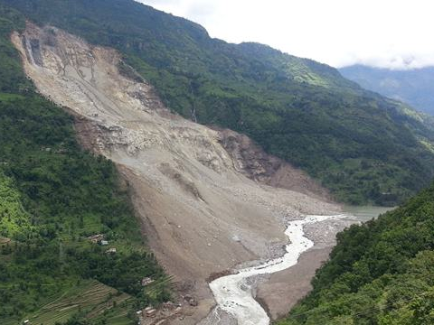
Landslide
Lake formation
settlements
Water flow after blasting

Slide 30
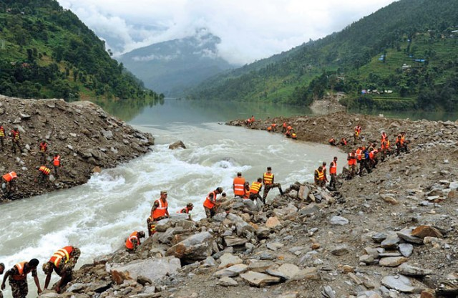
He
The Landslide
Lake formation
Lake formation
Water flow after blasting

Slide 31
“No” Floods 2014:
Response Timeline
02:21 am | Bhote Kosi landslide occurs, 2 August 2014.
08:30 am | Central Disaster Risk Reduction Committee, GoN – Emergency Meeting at Singhadurbar, Kathmandu.
11:36 am | GoN informs India’s NDMA, which alerts GoB → alerts District Disaster Committees within two-km of the river. Home Minister, GoN, Bam Dev Gautam urges the governments of China and India to help.
14:02 pm | Nepal Army makes first attempt to blast and break the dam unsuccessfully; declared downstream areas “Crisis Hit Regions”
3 August 2014
The National Crisis Management Committee (NCMC), GoI coordinates response efforts. C17 Military Aircraft with medical teams and Six expert members from India at Ground Zero for assisting Nepal Army. 44,000 people evacuated along Kosi River; 1.5 lakh to be evacuated by evening. Air Force and Navy on standby; 8 teams of NDRF and 4 teams of SDRF pressed into service Food Corporation of India directed to store additional food grain
Notes:
http://www.myrepublica.com/portal/index.php?action=news_details&news_id=8021,
Araniko Highway blocked, Sunima hydropower project inundated, SunKosi hydropower project downstream under risk.

Slide 32
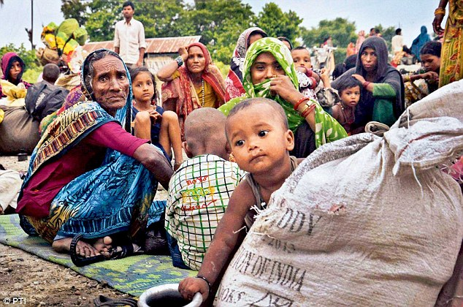
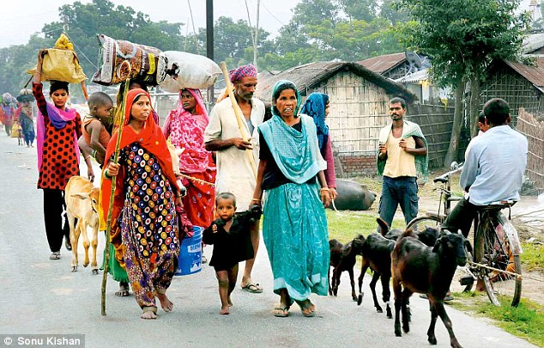
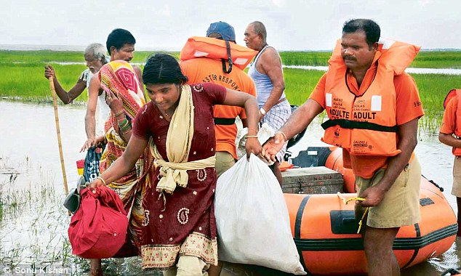
MAIL TODAY, 4 August 2014
Notes:
http://www.dailymail.co.uk/indiahome/article-2715002/Bihar-flood-fear-Central-government-step-action-Army-paramilitary-deployed-thousands-evacuated-danger-zone.html

Slide 33
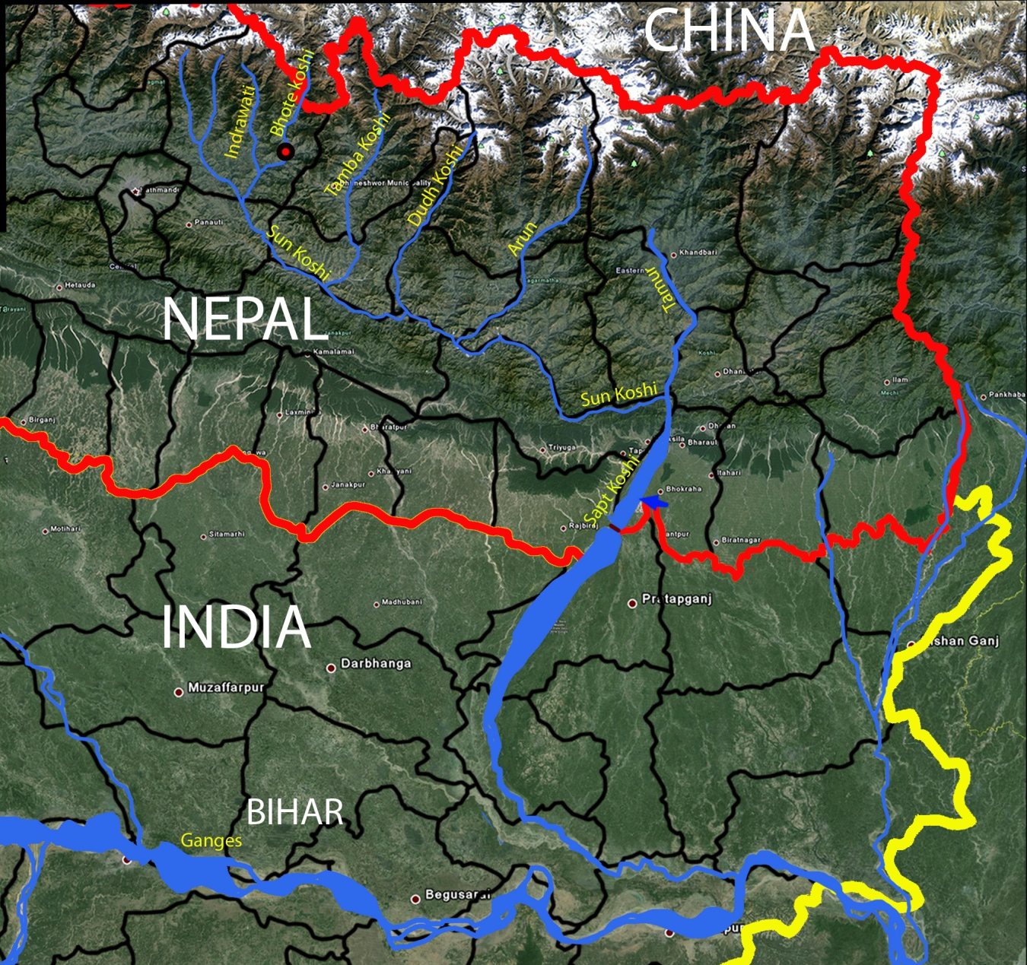
LEGEND
International Boundary
State Boundary
District Boundary
Rivers
Landslide site
Landslide site 2014
Breach 2008
Contrast the
two times…
Flood Affected Area

Slide 34
Contrast and Compare
Response in 2014 is clearly an ad-hoc response, but helped in mitigating adverse impacts:
Can/should NCMC respond to all such possible eventualities? What is the role of JWRC, KHLC, GFCC – the entire institutional infrastructure for Kosi transborder governance?
The instances of 2008 and 2014 – “hydrologically dissimilar”
Bhote Kosi’s runoff contribution less than 5%; 20 MCM is the maximum that will eventually turn into flood (CWC)
In 2014, CWC has had the benefit of access to real time data from Nepal’s hydrology information site to make projections and offer an objective assessment to NCMC – “Nothing to bother!”(CWC).
Insignificant stakes for India, yet why such high levels of mobilization?
Notes:
http://www.ndmindia.nic.in/

Slide 35
Nonstate Actors in Transboundary Governance:
Access to Information, Politics
Notes:
http://yfebiharfloodrelief.blogspot.in/2008_09_01_archive.html

Slide 36
Access to Information
Is 2014 response an outcome of institutional learning from 2008 floods? Not entirely …
Justice Balia Commission set up in 2008, gave its report in July 2014. Report remains inaccessible.
But why such ‘hype and overkill’ by state agencies?
The high profile Indian PM’s visit, Indian agencies did not want to leave any chance: Bihar’s Minister of Water Resources Bihar advised about “10 m height sheet of water flowing into Bihar”
What about nonstate actors?
Somehow appear not so active in 2008.
In 2014, reporting quick and efficient; but lacked accuracy.
This led to pressure, and also panic. Justifies ‘no access to nonstate actors’?
Certainly not. What if there was no high profile visit of the PM? Nonstate actors could have helped creating the necessary pressure? Perhaps.
Notes:
http://www.ndmindia.nic.in/

Slide 37
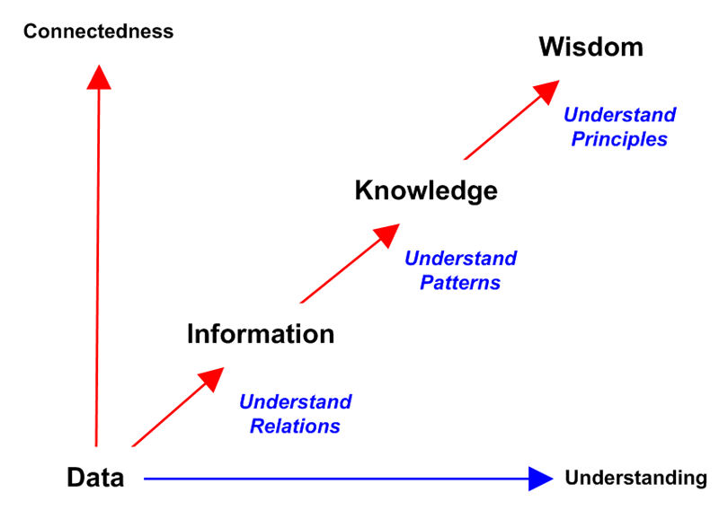
Access to Information
So, the right question is: what kind of access to information that will enable authenticity and accountability?
Institutionalize
a
political project
Contextualize
Questions of authenticity and accountability?
Organize
Image: Adapted from Bellinger, Castro and Mills 2004, drawing on Ackoff 1988’s DIKW hierarchy

Slide 38
Access to Information:
Policy Implications
There is a clear need to reconsider means and practices of access to authentic information.
What kind of accountability and authenticating practices needed for dissemination by both state and nonstate actors?
Should we revisit the Hydro-meteorological Data Dissemination Policy 2013?
Revisit Kosi Treaty scope and institutional set up?
“…while each country is required to give to the other the data resulting from its surveys and investigations on the “Kosi in Nepal,” there is no provision about the exchange of data on the “Kosi in India.”” (Salman and Upreti 2003: 74). In this “hegemony” or lack of focus on disaster response coordination?
Transboundary governance institutional setup is primarily to maintain flood protection works. Rethink with considerations of disaster response?
The 2014 instance of ad-hoc mobilization is not an exception. Many instances of cooperation occurred outside the scope of treaty (CWC).
A case for more comprehensive transboundary governance? How?
Notes:
http://www.ndmindia.nic.in/

Slide 39
Managing Multiscalar Politics
Kathmandu
Kosi (Nepal)
Antagonism and mistrust Geopolitics (Nepal, India, China, Bangladesh) Turbulent politics in Nepal Porous border Transborder economic interdependencies Record of transborder cooperation (ad-hoc, exigency driven) | For High Dam for greater flood protection, electricity and irrigation benefits Against High Dam - increased vulnerabilities Poor record of rehabilitation compensation and benefits Sense of discrimination by Kathmandu – subnational politics
Ambiguous commitment from both governments about High Dam or other alternative protection measures Resistance and tenuous subnational politics around embankments Bihar government for High Dam, but unsure about the Centre | “Roti-Beti” sambandh - strong socio-economic and cultural affinities Collective coping with floods Irrigation, electricity, flood protection benefits EMBANKMENT (MIS)ECONOMICS and nexus with flood protection– tenuous subnational politics
Delhi
Kosi (India)

Slide 40
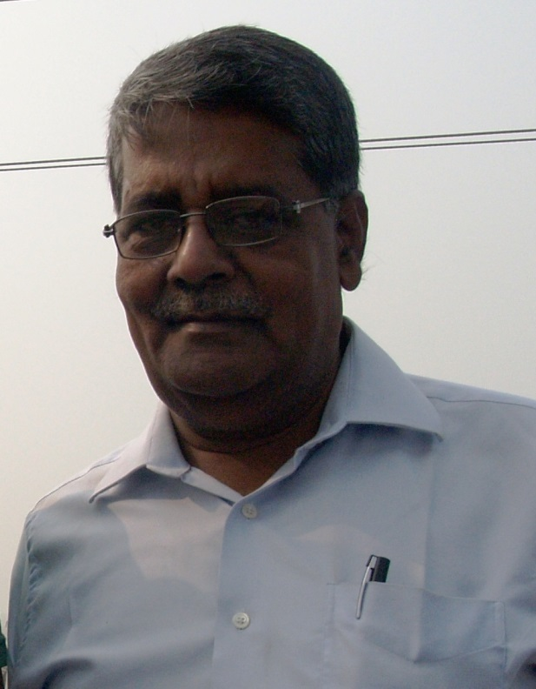
Remembering …
Vijay Kumar ( -2015)

